Slide 1

NLP and Clustering of YouTube Music & Movie Videos
YouTube sentiment analysis Project
Course: Advanced topics in machine learning
Lecturer: Dr. Chen Hajaj
Team Members: Dor Ingber & Itai Bekenshtein

Slide 2
The Problem We're Addressing
User-generated content on YouTube is vast and reflects diverse sentiments.
Understanding audience sentiment towards music and movies is valuable for content creators and marketers.
Current approaches to sentiment analysis often neglect the unique context of YouTube video descriptions and titles.

Slide 3

Original Project Goals
Extract sentiment from YouTube video titles and descriptions.
Cluster videos based on their dominant sentiment.
Provide insights for content creators and marketers to tailor their offerings and marketing strategies.

Slide 4

Other Methods & Techniques
Other Potential Approaches:
Supervised Machine Learning: Requires large, labeled datasets to train models. Models learn to predict sentiment based on provided labels (positive, negative, etc.).
Deep Learning: Advanced techniques using neural networks. Can excel at complex sentiment analysis but often require substantial computational resources and massive datasets.

Slide 5
Other Methods & Techniques
Why We Chose Unsupervised Learning:
No Labeled Data: Manually labeling sentiment for a large YouTube video dataset can be extremely time-consuming and expensive.
Exploratory Analysis: We wanted to uncover patterns in the data and identify the dominant sentiments without prior assumptions about specific emotions.

Slide 6
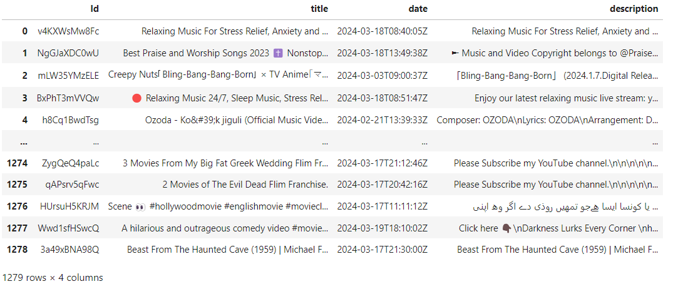
Dataset and Features
First Data:
Source: YouTube Data API v3
Features: ID, Title, Description, Date

Slide 7
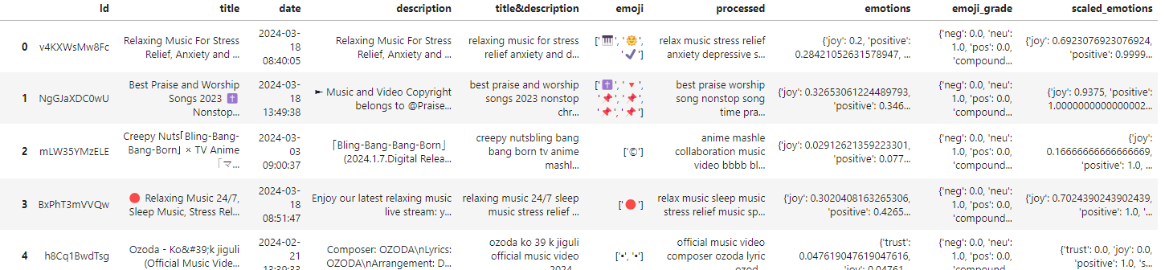
Dataset and Features
Second Data: After NLP process
Features: ID, Title, Description, Date, title&description , emoji, processed, emotions, emoji_grade, scaled_emotions

Slide 8
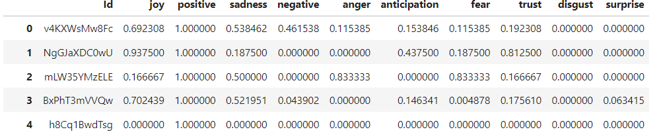
Dataset and Features
Third Data: emotions data frame
Features: Id, joy, positive, sadness, negative, anger, anticipation, fear, trust, disgust, surprise

Slide 9
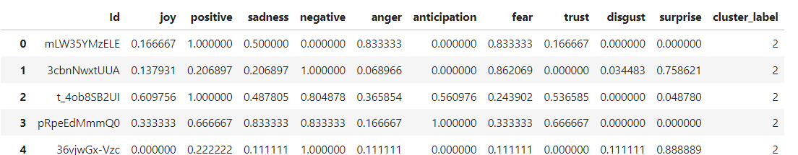
Dataset and Features
Forth Data: Clusters data frame
Features: Id, joy, positive, sadness, negative, anger, anticipation, fear, trust, disgust, surprise

Slide 10

Methodology
NLP
Libraries used (VaderSentiment, spaCy, NRCLex).
vaderSentiment - for analyzing emotions from emojis.
spacy - Stop word removal, Lemmatization, and entity removal.
NRCLex - dealing with sentiment analysis from text.
We used MIN MAX Scaler to normalize sentiment scores for each video. We wanted to normalize the sentiments to highlight dominant emotions and reduce the scores of minor emotions.

Slide 11


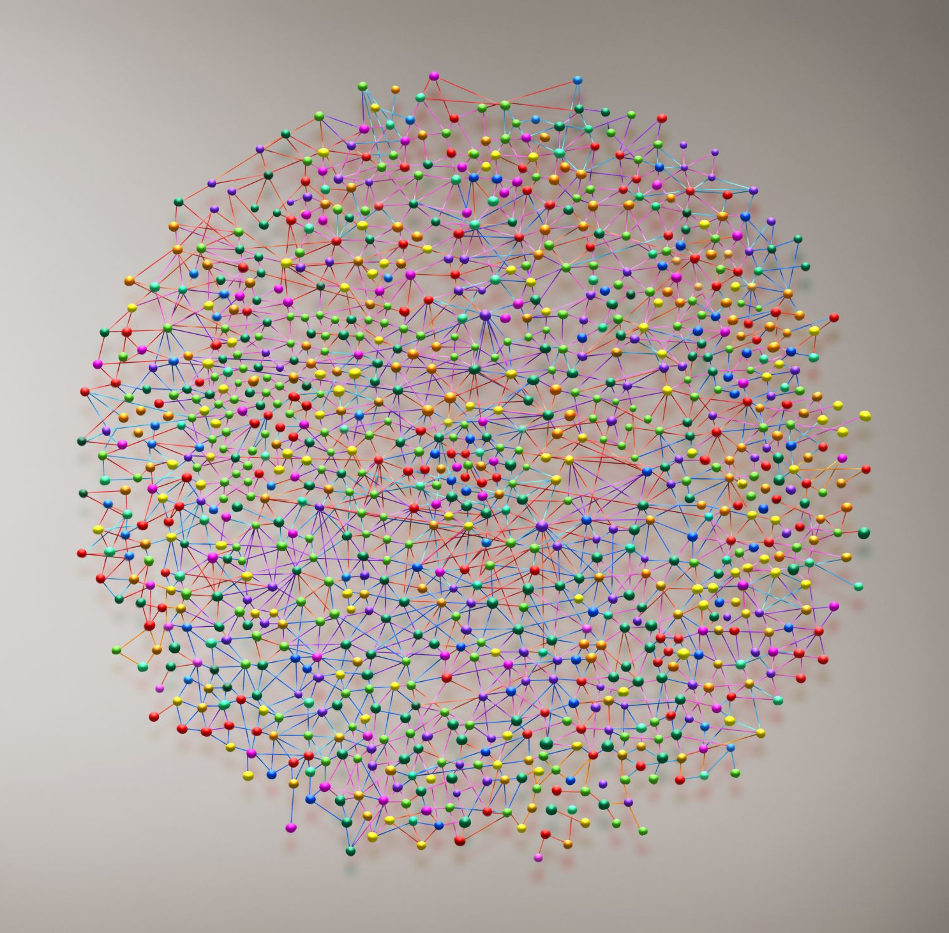
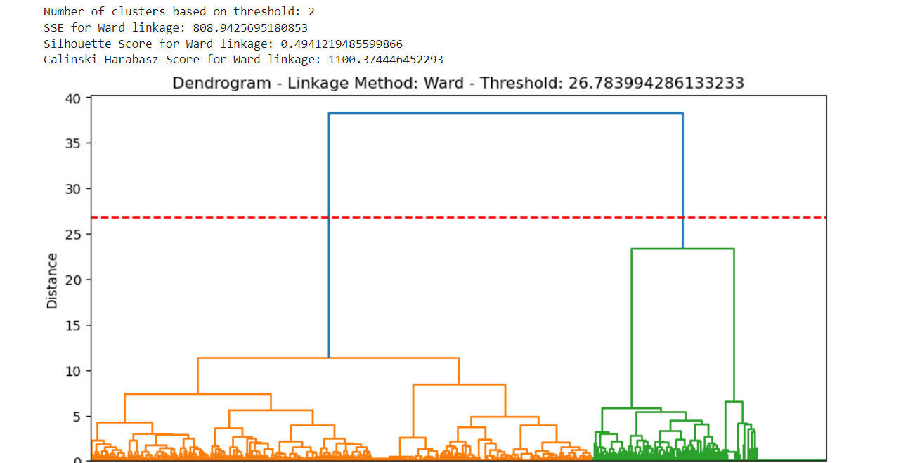
Methodology
Clustering
Hierarchical Clustering:
Forms a hierarchy of clusters based on distances between data points.
Offers a visual representation of the data's hierarchical structure (dendrogram). and identifying natural clusters in the data.
Threshold explains 70% of the data

Slide 12
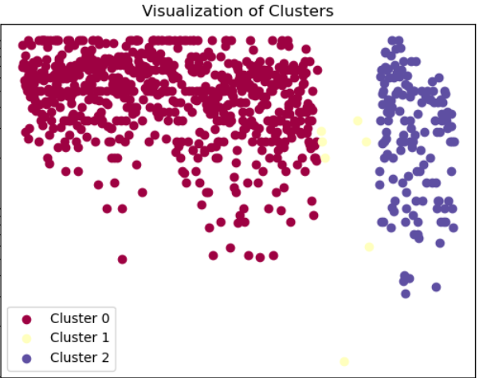
Methodology
Clustering
K-means Clustering:
Partitions data into a fixed number (k) of clusters.
We tried this model because its clear separation of data points into clusters makes it easy to identify and understand the different groups present in the data.

Slide 13
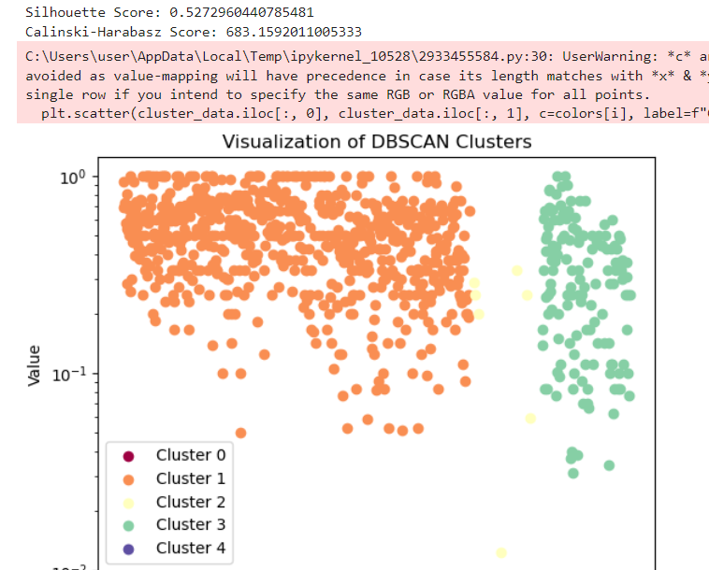
Methodology
Clustering
DBSCAN Clustering:
Groups data points based on their density in a neighborhood.
Does not require a pre-defined number of clusters.
We tried this model because we wanted to diagnose a model that works on density and not on distance calculation

Slide 14
Experiments
Parameter Tuning:
Hierarchical Clustering:
We measured the results for changes in the hyperparameters of this model. Calculating result for each linkage method.
K-means Clustering:
To find K, we pairs of emotions with the highest correlation between them. We used “networkx “to create a graph to find groups of closely related emotions based on their correlation. We checked the natural clusters from the Hierarchical model as well.
We measured the results for changes in the hyperparameters of this model. Calculating distance, number of iterations, and different choices for the initial location of the cluster centers.
DBSCAN Clustering:
We measured the results for changes in the hyperparameters of this model. Calculating different values for epsilon and minimum points parameters.

Slide 15
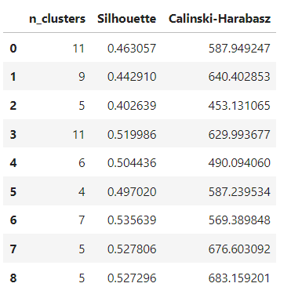
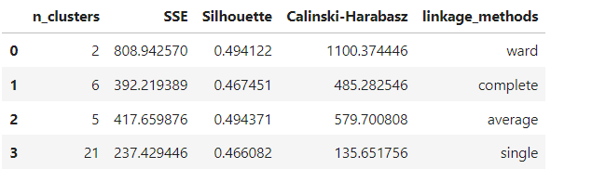
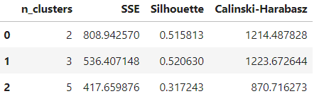
Experiments
Evaluation Metrics:
SSE, Silhouette Score, Calinski-Harabasz Index
DBSCAN
Hierarchical Clustering
K-means

Slide 16
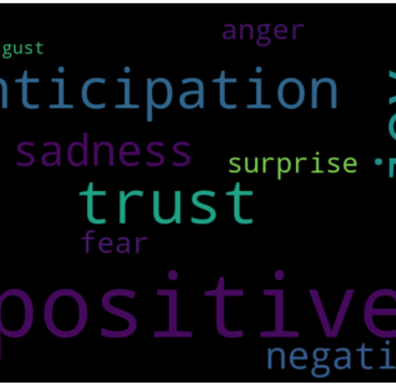
Results
Best-performing model was k-means.
Insights from the clusters based on sentiment patterns:
Cluster 0: Predominantly Positive
Dominant Emotions: 'positive', 'joy', 'trust', 'anticipation'
Videos in this cluster seem to convey strong positive emotions, likely expressing enthusiasm, happiness, a sense of trust, and excitement about the content. This cluster might include music videos with upbeat tunes or videos with messages of optimism and hope.

Slide 17
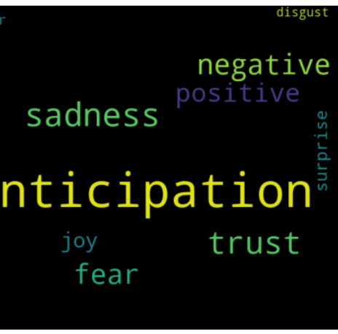
Results
Cluster 1: Mixed Emotions with a Lean Towards Sadness
Dominant Emotions: 'anticipation', 'sadness', 'trust', 'negative', 'fear'
This cluster suggests a mix of emotions, with a noticeable presence of sadness and negativity. Some anticipation and trust might suggest underlying hopefulness, while fear adds a touch of apprehension. This cluster could include dramatic movie scenes or videos dealing with loss or difficult life experiences.

Slide 18
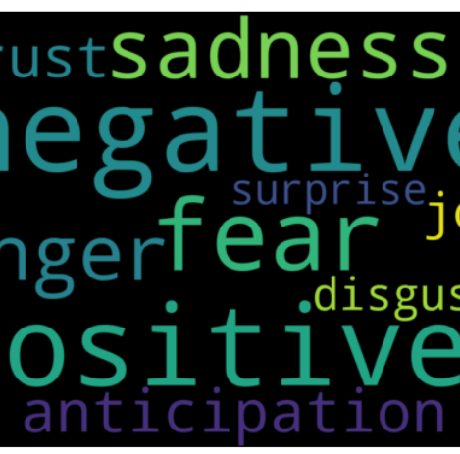
Results
Cluster 2: Complex Mix of Positive and Negative Emotions
Dominant Emotions: 'negative', 'positive', 'fear', 'sadness', 'anger'
This cluster showcases a complex mixture of emotions. There's a clear presence of negativity, fear, sadness, and anger, but there's also a strong undercurrent of positive sentiment. Videos in this cluster might explore difficult topics, videos that spark debate or controversy, or videos depicting emotionally-charged moments.

Slide 19

Any Questions?

